Slide 1
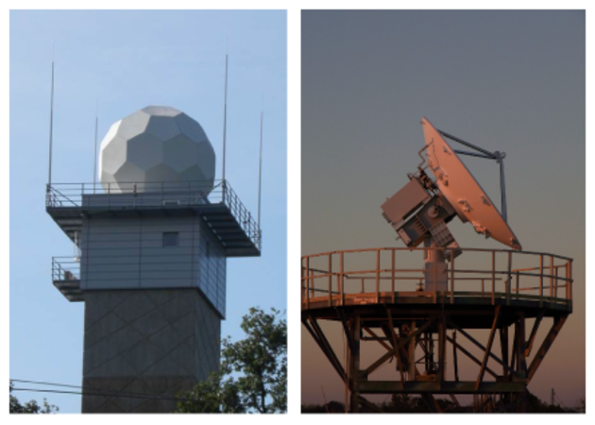
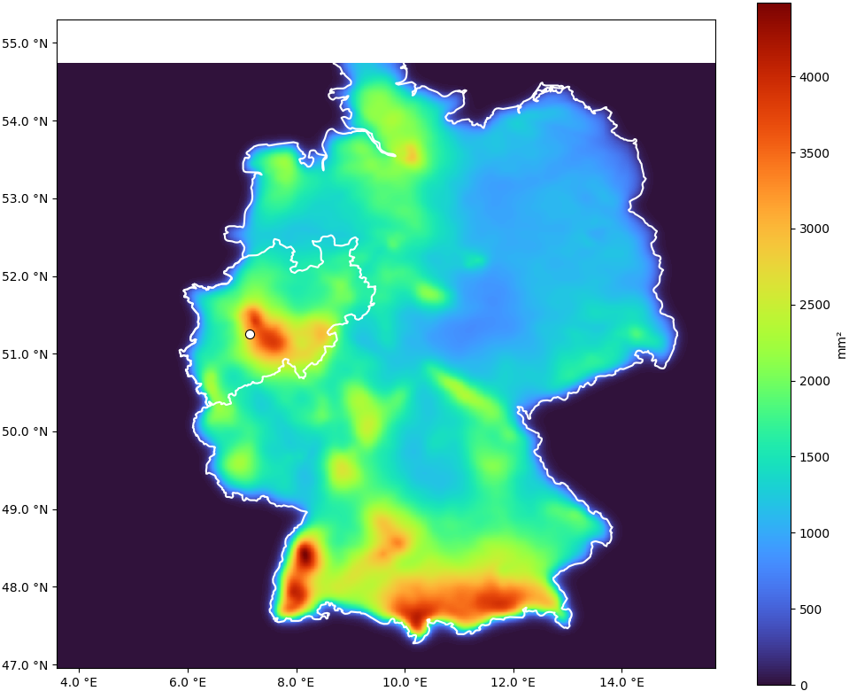
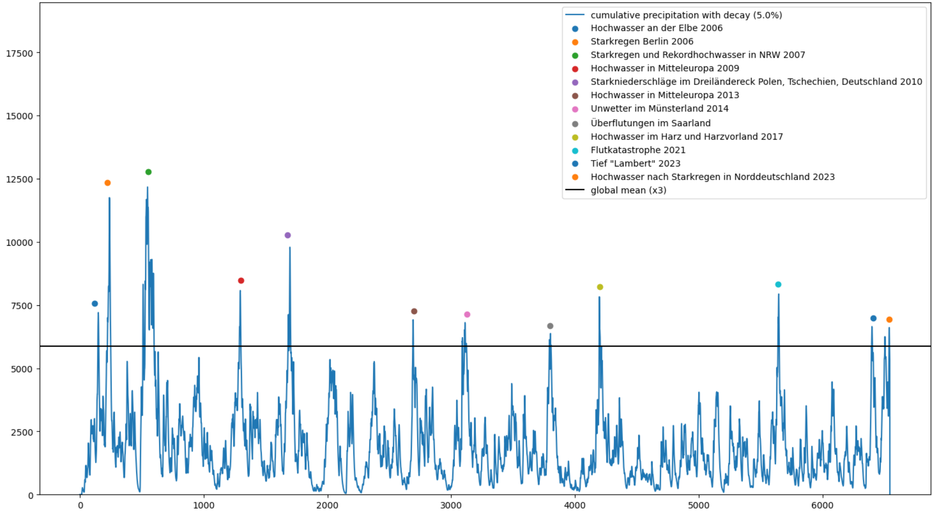
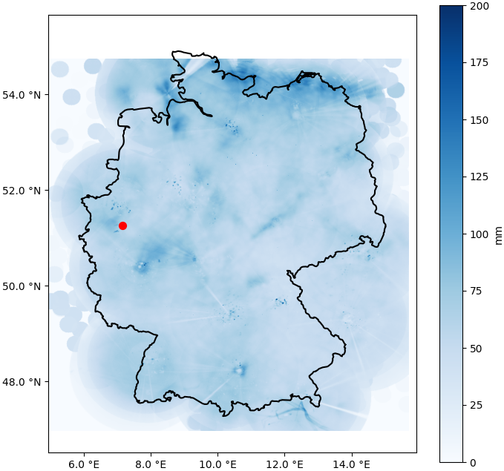
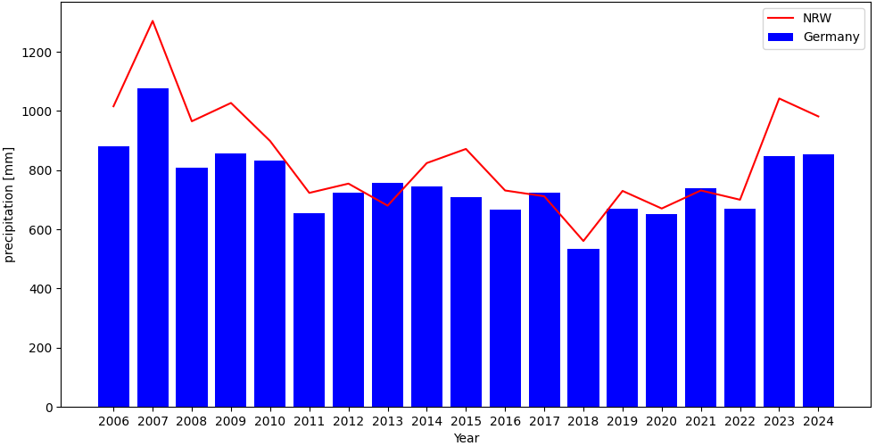
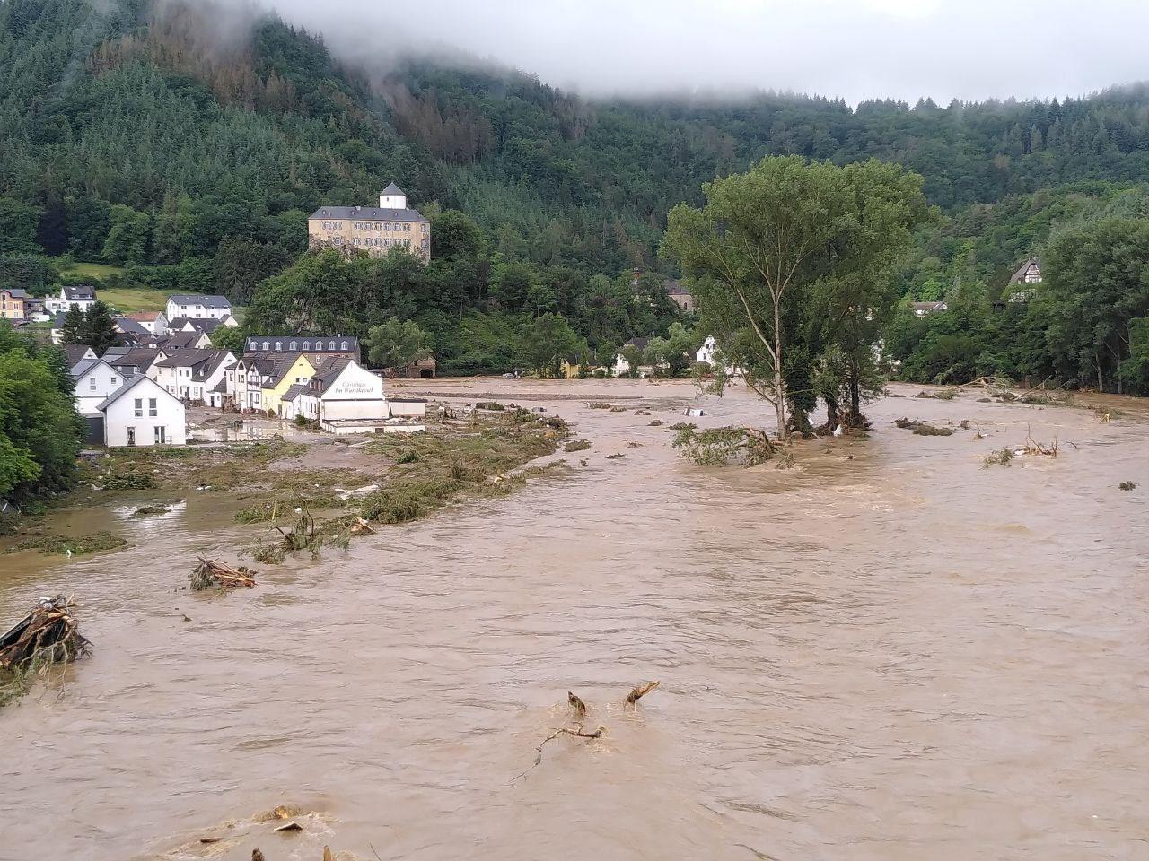
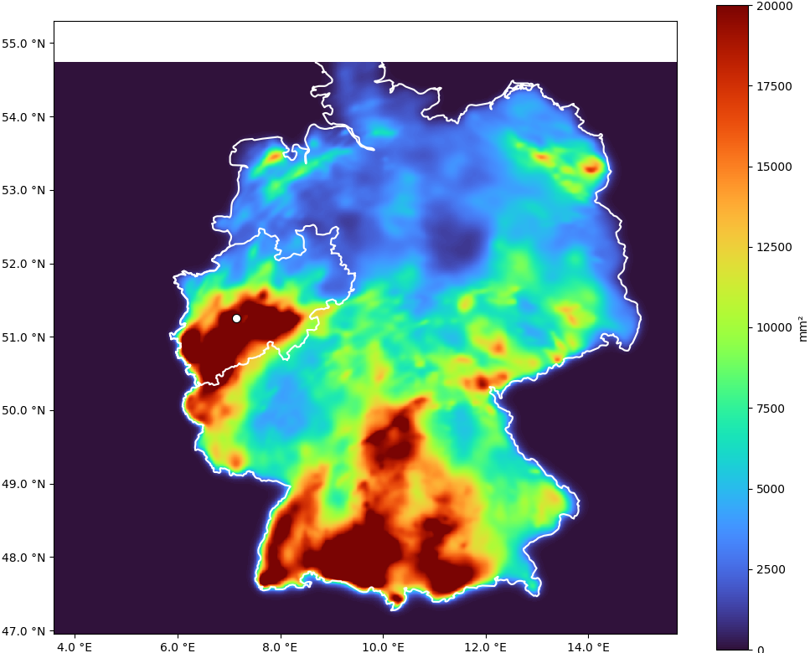
Data Analysis to Protect Against Climate-Driven Extremes
Data Analysis to Protect Against Climate-Driven Extremes
Wuppertal, 05.02.2025
Wuppertal, 05.02.2025

Slide 2
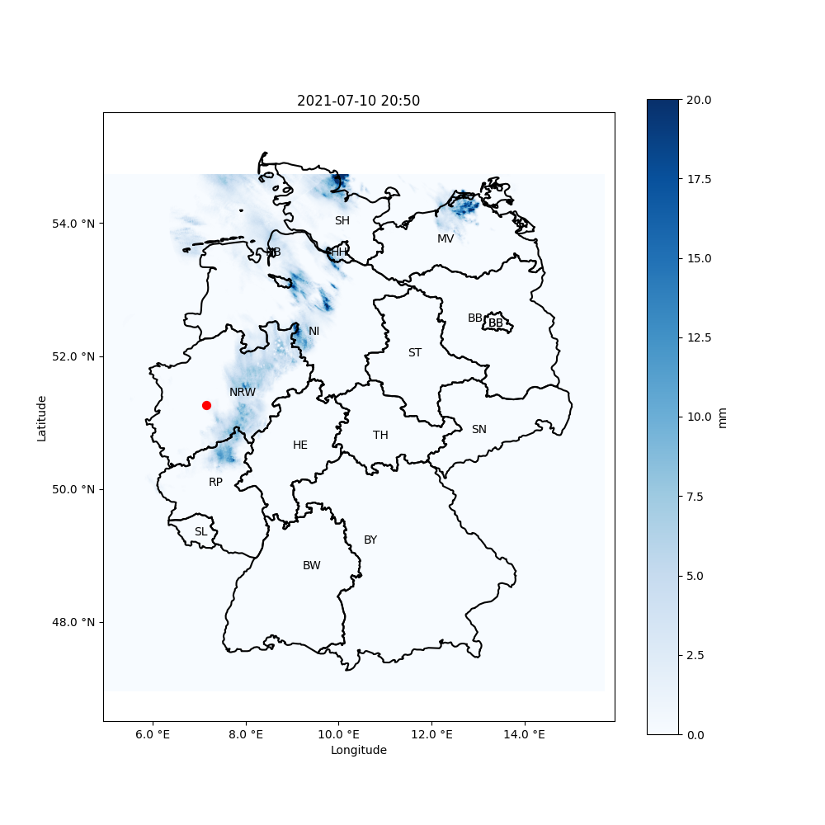





The Dataset
Introduction
Preprocessed Precipitation Radar Data
Deutscher Wetterdienst (DWD)
Dataset Size: 12GB compressed, 637GB uncomp.
Recording Interval: 10 minutes, hourly
Time Range:
2006
2024
19 years

Slide 3
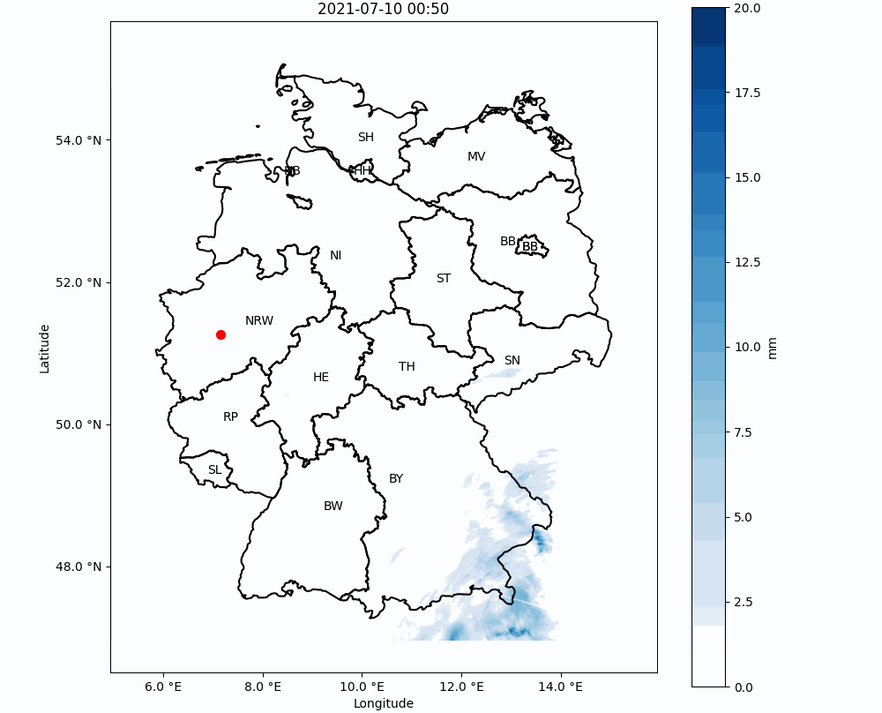
Introduction

Slide 4
Precipitation per Year
Basic Trends
Notes:
NRW has higher precipitation
Slight downtrend, but not statistically significant

Slide 5
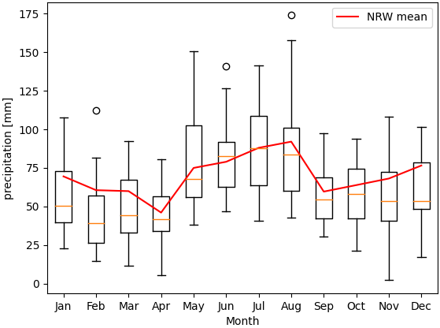
Precipitation per Month
Basic Trends
Notes:
NRW has higher precipitation
Slight downtrend, but not statistically significant

Slide 6
Precipitation per square kilometer
Basic Trends
Notes:
NRW has higher precipitation
Slight downtrend, but not statistically significant

Slide 7
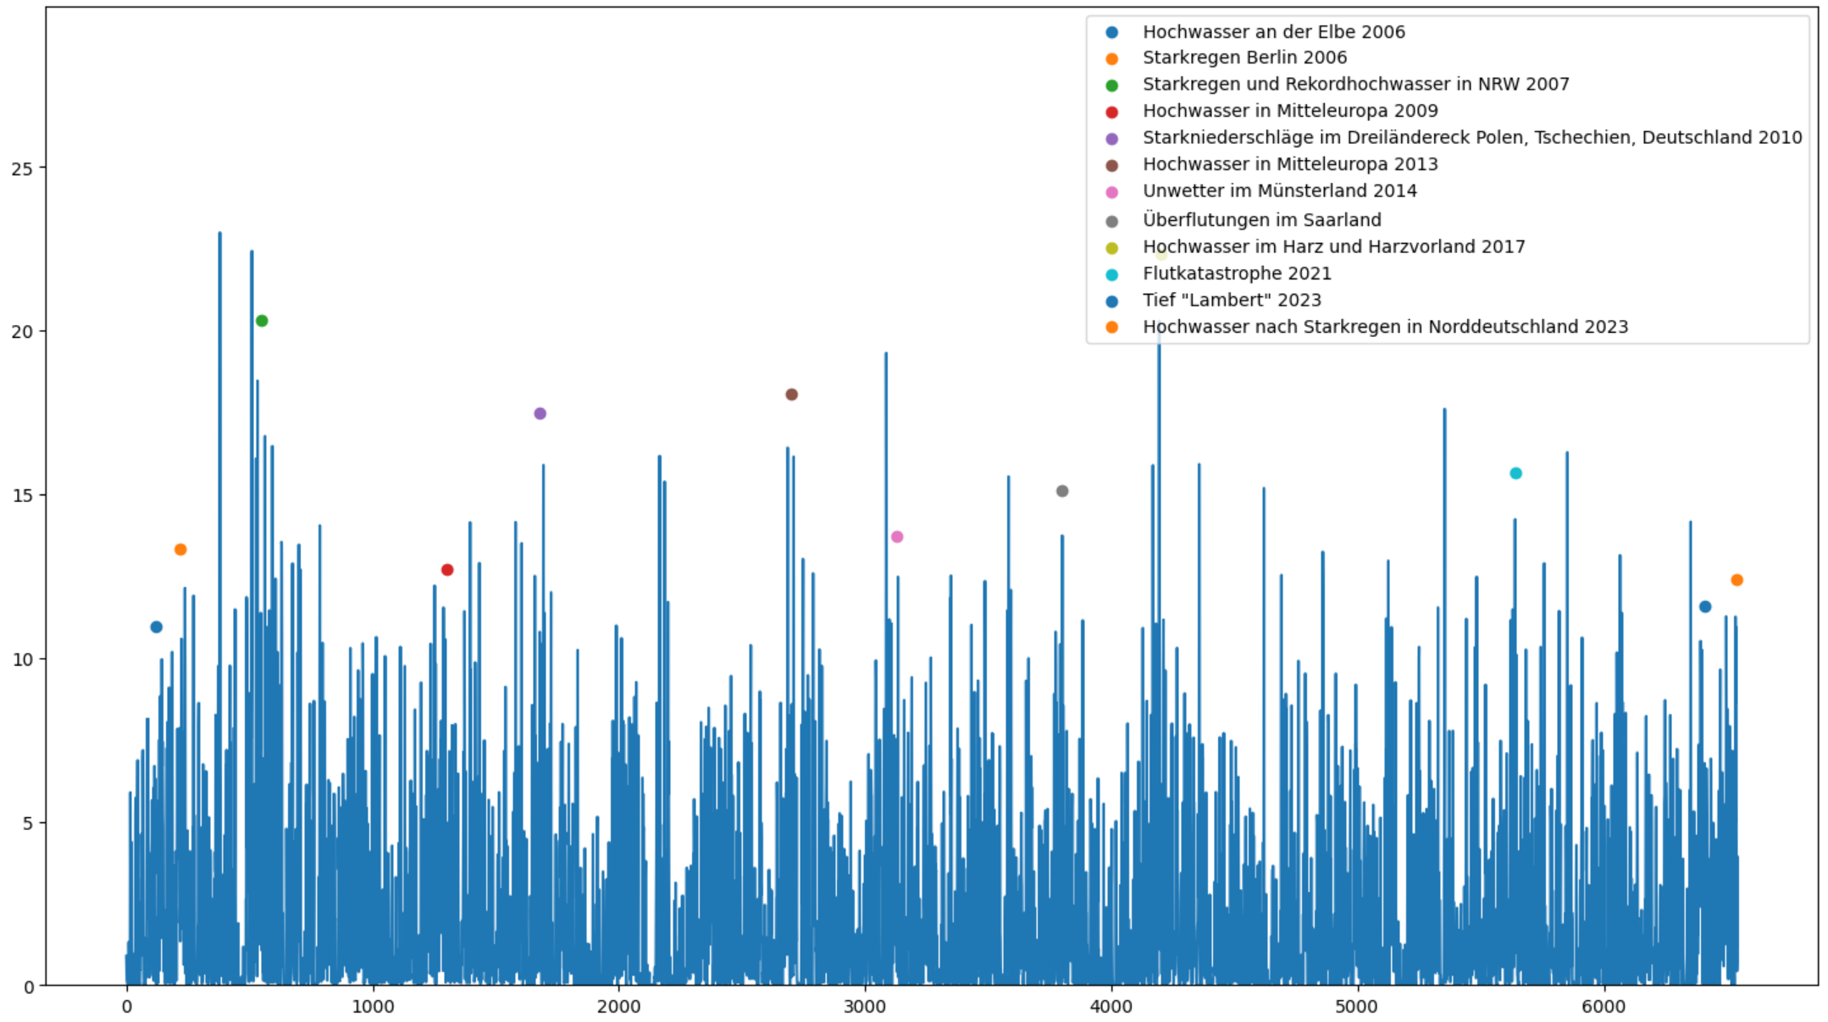
Daily Precipitation and Major Weather Extremes
Detecting Weather Extremes

Slide 8


New Hypothesis
Detecting Weather Extremes
Not always lead to
Observations:
Very high precipitation in 24 hours does not always lead to weather extremes
A weather extreme does not always have high precipitation in 24 hours
High 24h Precipitation
Weather Extremes
Not always have
New Hypothesis:
The accumulation of precipitation leads to weather extremes.

Slide 9

Cumulative Precipitation with Decay (CPD)
Detecting Weather Extremes
New metric measures the accumulation of precipitation while factoring in runoff/decay over time
Decay Factor (95%)
$${CPD}_{i}={CPD}_{i−1}∗α+p_{i}$$
New accumulation value
New precipitation
Old accumulation value

Slide 10
Daily CPD and Major Weather Extremes
Detecting Weather Extremes
3 times of mean
as threshold

Slide 11
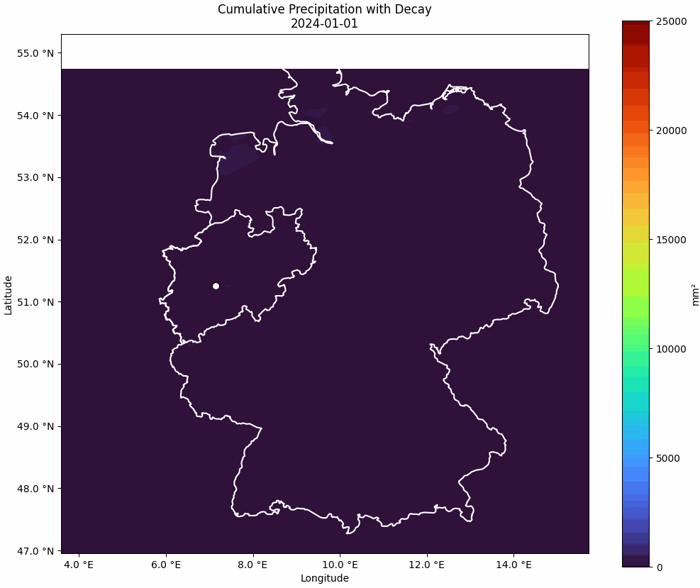
Daily CPD of 2024
Detecting Weather Extremes

Slide 12
CPD of the 2021 flood disaster
Detecting Weather Extremes

Slide 13
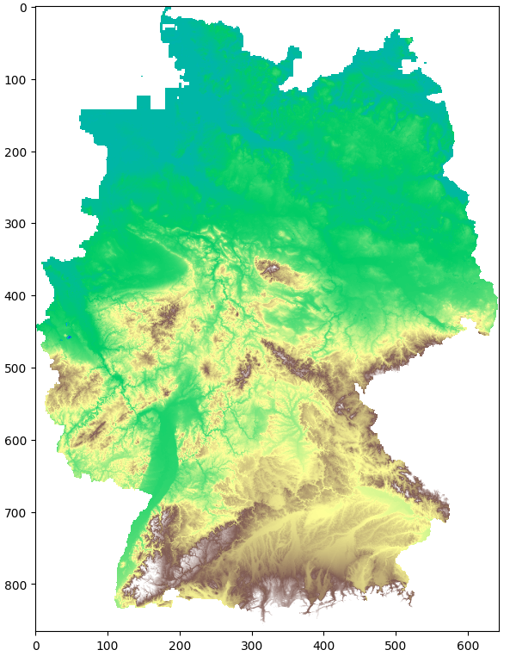
CPD as an average over Germany
Detecting Weather Extremes

Slide 14
CPD as an average over Germany
Detecting Weather Extremes

Slide 15




Limiting factors of radar precipitiation data
Building an Early Warning System
Precise water absorption
different absorption based on the substrate and saturation
Topography
unabsorbed water flows in the direction of steepest descent (aka valleys)
Water levels
Water levels and fill heights of rivers, lakes, dams and reservoirs have a large influence on whether water escapes
Accumulations of snow
snow that has already fallen can melt and contribute to flooding

Slide 16

Thank you for your attention!

